Slide 1
Ride Austin Analysis
Team
Andrew Scott
Brandon Leal
Aritra Ghosh
Alex Garfias

Slide 2
Project Inspiration
Ridesharing is a multi billion dollar industry has revolutionized the entire carpooling and taxi service experience.
Provides a comfortable and safe mode of transport where riders can choose from a wide variety of vehicles based on their preference and requirements.
Provides service in less populated or poorer areas that are not regularly served by taxicabs and charging lower rates than taxicabs.

Slide 3

Data Source
We came up with an idea of plotting rideshare data for the City of Austin, TX; we found a data set which we think provides great information that can be somehow easily analyzed and plotted with either leaflet, Java and/or D3 among other coding methods.
The source:
https://data.world/andytryba/rideaustin

Slide 4
Austin Ride Share Analysis
Andrew - Analyzing ride share data to show a Leaflet heat map of ride departures within Austin Texas, hoping to identify popular areas of Austin.
Alex –Will analyze the ride share data driver ratings, very likely will use D3 to create an interactive graph.
Aritra – Will analyze the most popular vehicles being used and also the number of rides per car brand, will likely be using plotly to create an interactive graphs showcasing the data.
Brandon -Will be tackling the back end. Flask routing to the MySQL DB.

Slide 5
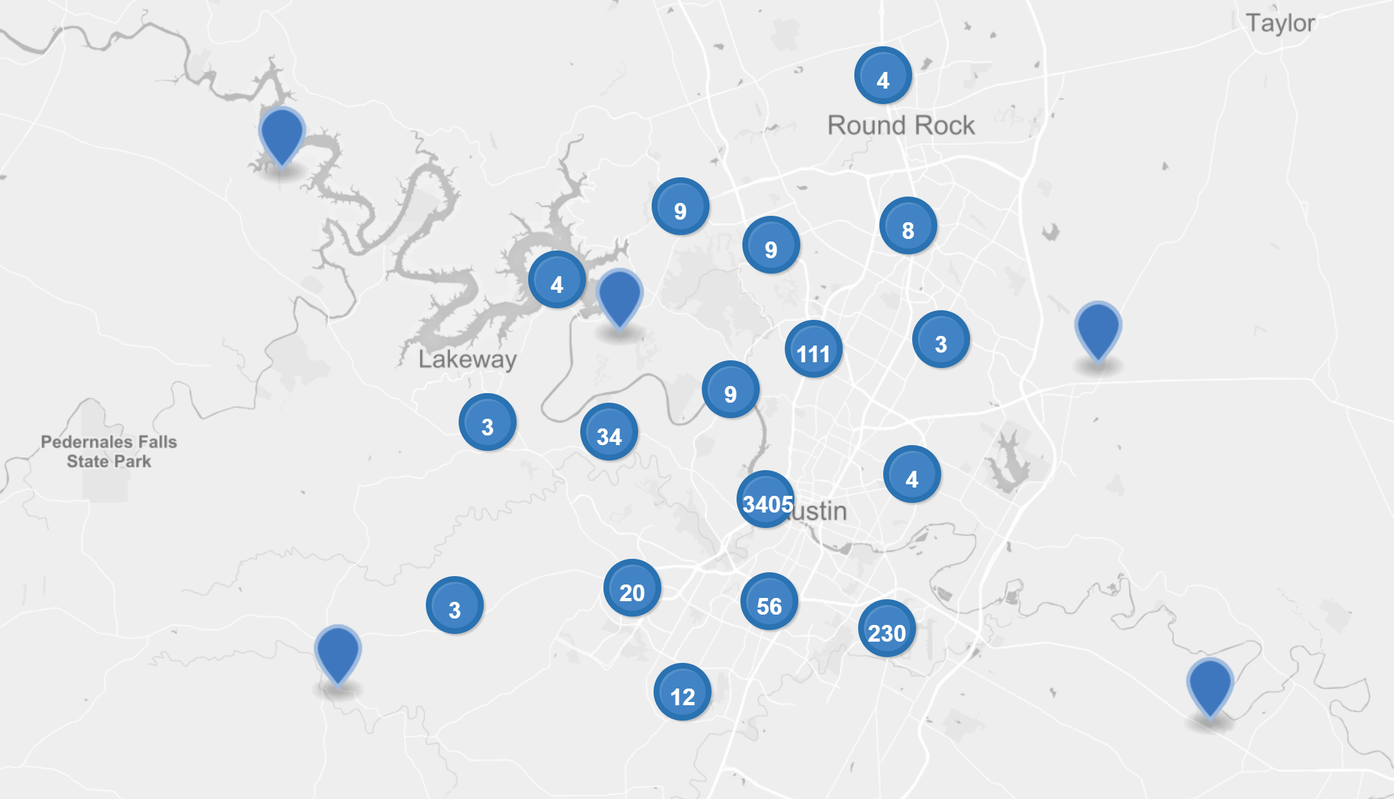
Project analysis slide 3
Ride Departures

Slide 6
Project analysis slide 4
Most Popular Vehicles

Slide 7
Project analysis slide 6
Number of Rides per Auto Make

Slide 8
Project analysis slide 5
Driver Rating

Slide 9
Thank You

